Slide 1
ALL-IN-FOCUS IMAGE CAPTURE USING LENS SWIVEL
Indranil Sinharoy
Prasanna Rangarajan
Advisor: Marc Christensen
Abstract
A camera can only focus on a single plane, which is at a precise distance from a camera. Consequently, objects in front of and beyond the plane that is in sharp focus appear blurry in a photograph. The ability to capture a sharp image of objects at multiple depths is highly desirable in several applications including optical microscopy, machine vision, and surveillance imaging. We propose a new method for creating an all-in-focus photograph by processing images acquired as the lens is swiveled about a pivot point in the camera. The principal advantage of our invention over prior art is the reduced number of images needed to assemble an all-in-focus image, especially in scenarios wherein the scene depth is infinitely large. The accuracy of the model has been verified through optical ray tracing. Using this new model, we have also found the special conditions required for capturing images for all-in-focus imaging using lens swivel.

Slide 2
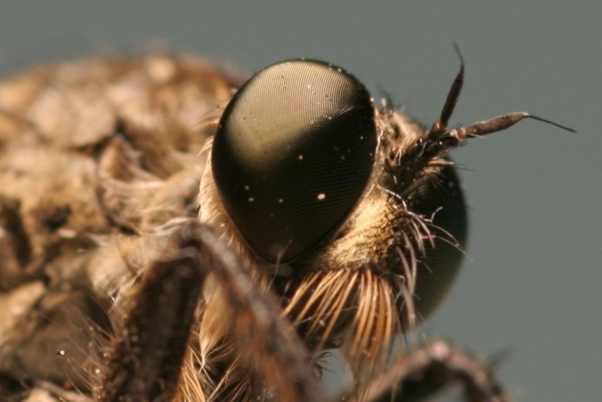
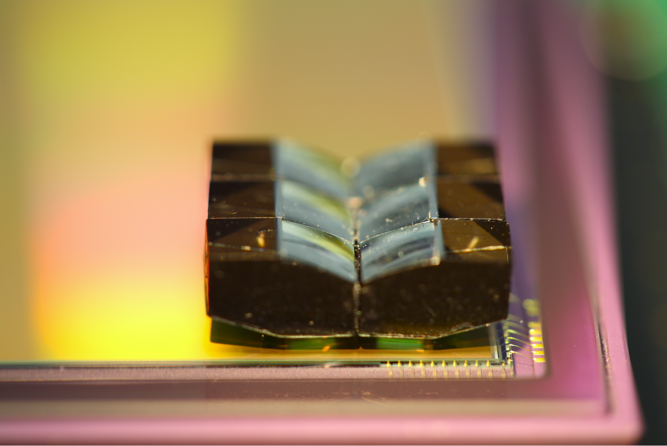
A PROBLEM
It is physically impossible for a camera to focus at multiple depths simultaneously – i.e. limited depth-of-field.
This BLURRING problem arises in all fields that employ imaging, especially in macro-photography, optical microscopy, machine vision and surveillance.
PLANE OF SHARP FOCUS
PLANE OF SHARP FOCUS

Slide 3

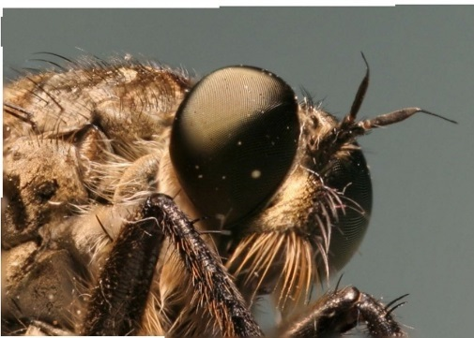
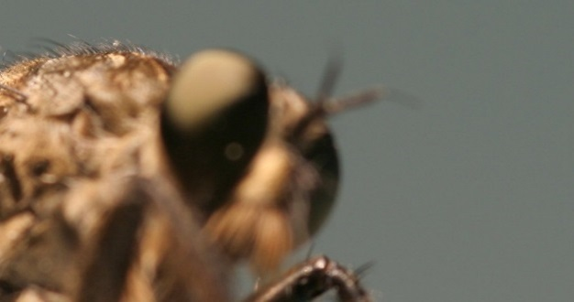
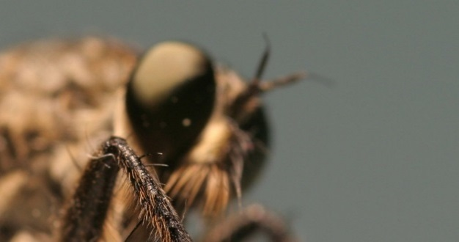

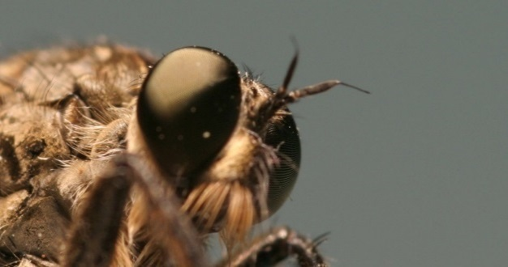
PRIOR ART
Capture multiple images at different focal depths by translating the sensor plane along the optical axis.
Blend in-focus (sharp) patches from individual images following registration and appropriate scaling.
y
OPTICAL AXIS (OA)
x
z
LENS
PLANE-OF-SHARP-FOCUS
SENSOR PLANE
=
…
(Blended in Photoshop)
Source: “All in Focus Image by Focal Stacking-Input Images,” by Liu Feipeng

Slide 4
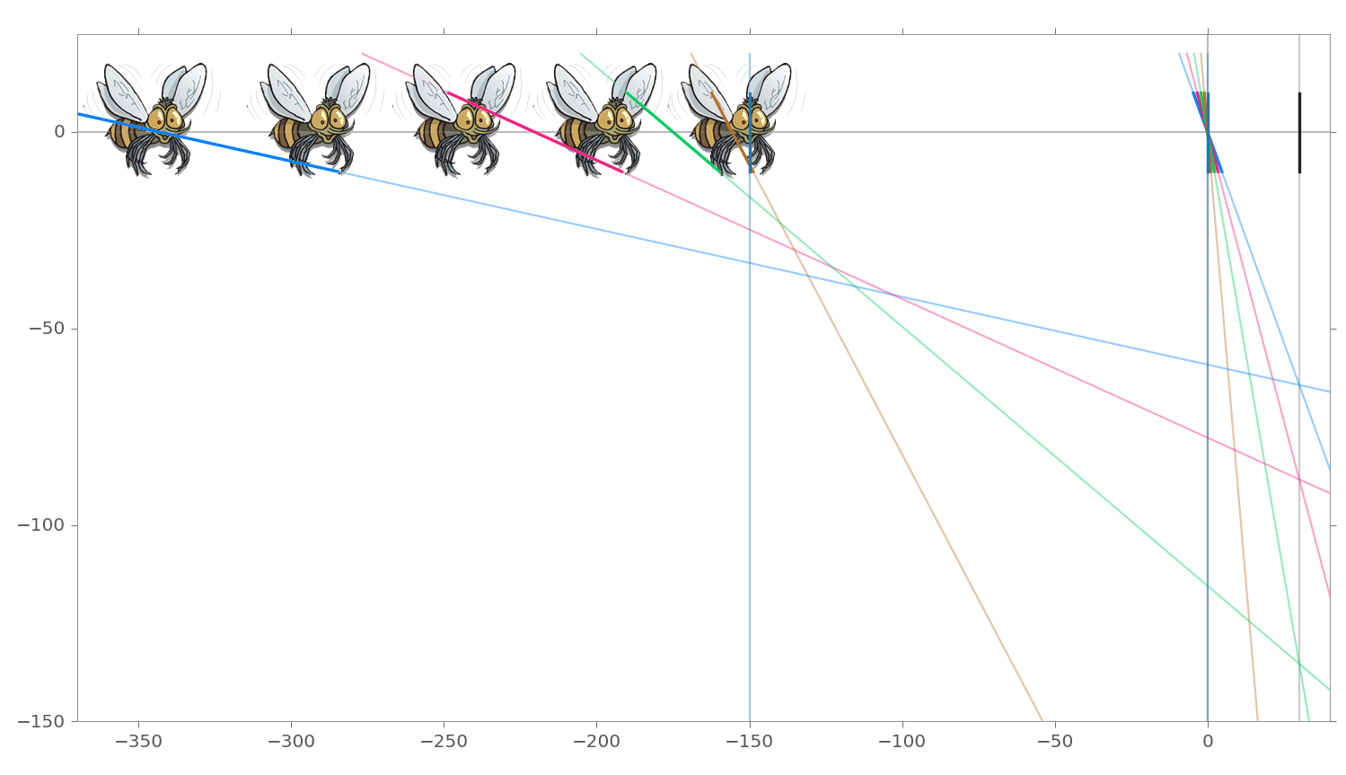
A SOLUTION
Swivel the lens about a pivot point.
Planes-of-sharp-focus angularly sweeps the object space.
OPTICAL AXIS (OA)
PLANE-OF-SHARP-FOCUS
SENSOR PLANE
y
x
LENS
z

Slide 5
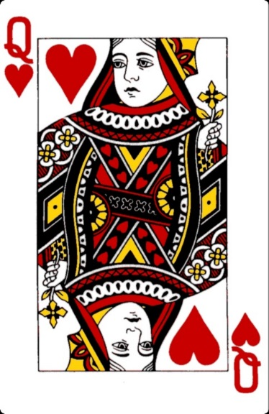

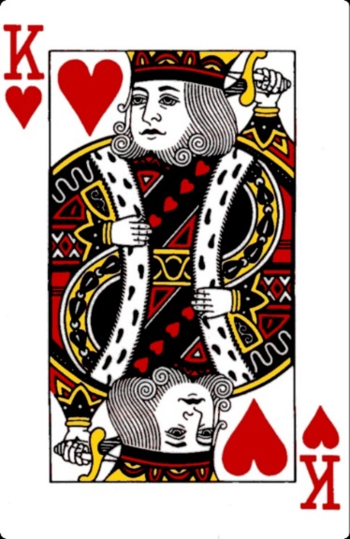
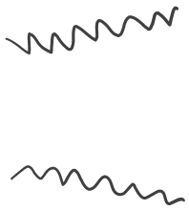
A SIMULATION
Simulation setup (Using Zemax and Python):
Optical ray tracing
Paraxial thick-lens model with spherical aberration
Focal length = 24 mm, Aperture = F/2.5
LENS
SENSOR PLANE
200 mm
200 mm
800 mm
y
x
z

Slide 6
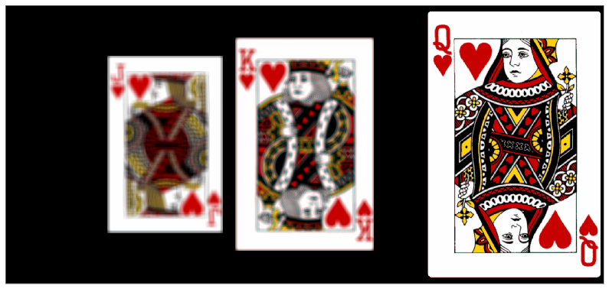
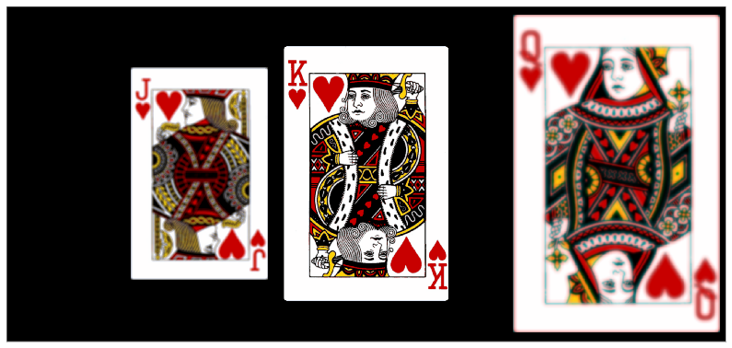
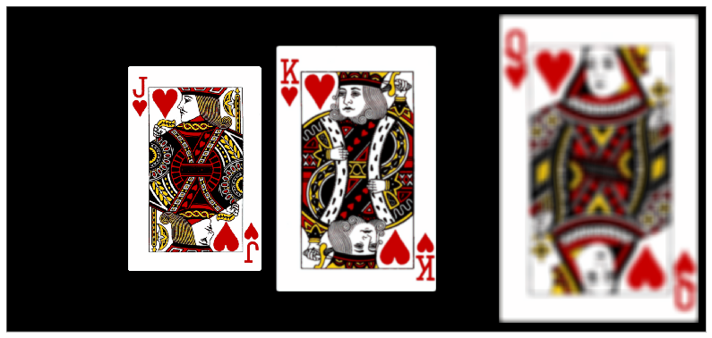
A SIMULATION
Fronto-parallel (conventional) imaging. The lens focuses on each plane individually (red arrow)

Slide 7
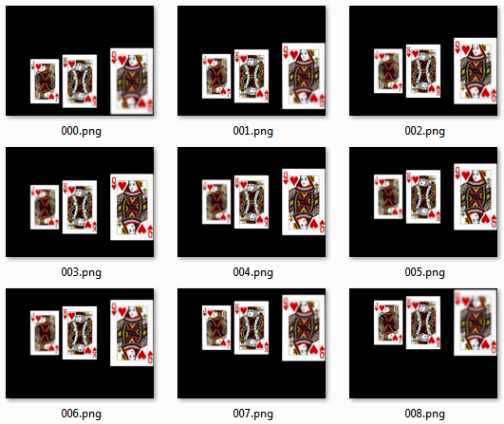
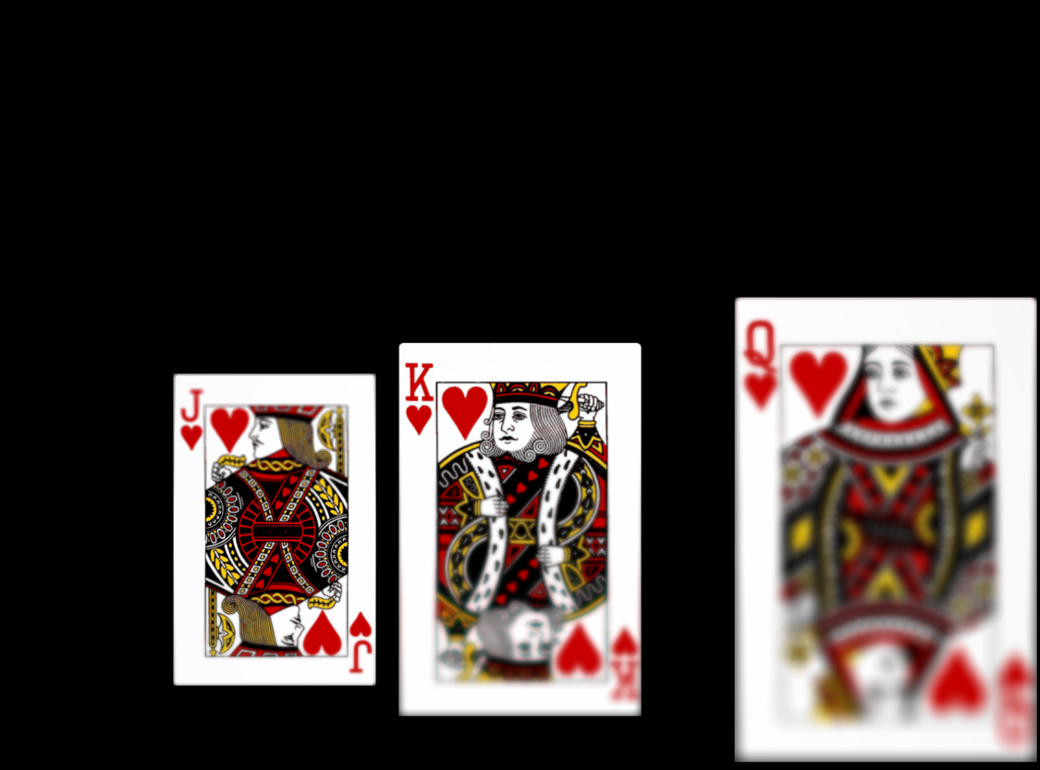
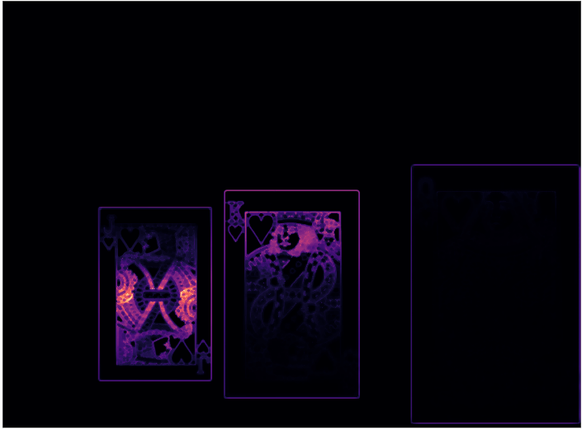
A SIMULATION
000.png (lens tilt = -6°)
Zone of sharp focus
Focus measure (LoG)
000.png (lens tilt = -6°)
Lens tilt (9 images -6° to +6°)
Images formed on the sensor.
Image for lens at -6°.
Automatic detection of sharp focus region using the LoG.
▴
▴
▴

Slide 8
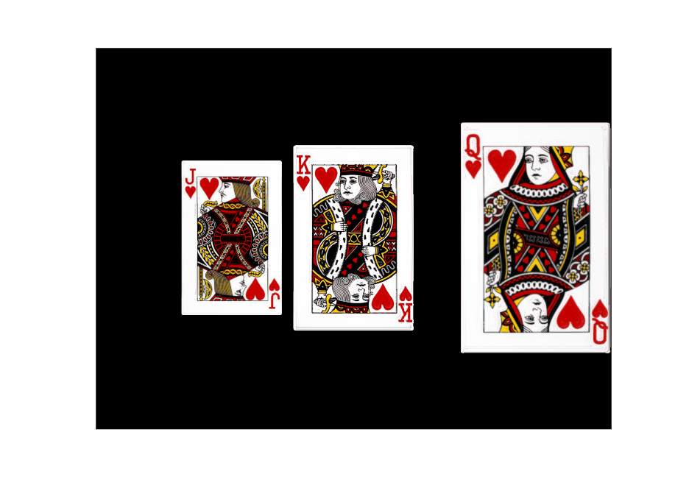
A SIMULATION
Composite image following image registration and scaling
Focus measure = Laplacian of Gaussian (LoG)

Slide 9
COMPARISON (with prior art)
Advantages
Near-infinite depth-of-field with far fewer image captures
Simple reconstruction procedure (if pupil-magnification equals unity)
Limitations
If pupil-magnification is not one (most off-the-self lenses) image alignment becomes non-trivial.
Other possibilities
Selective focus and after-the-fact focusing (like Lytro)
Scene depth estimation

Slide 10
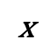
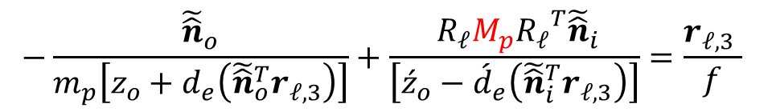
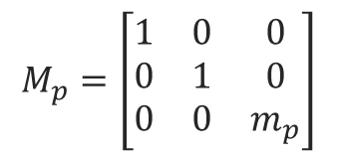
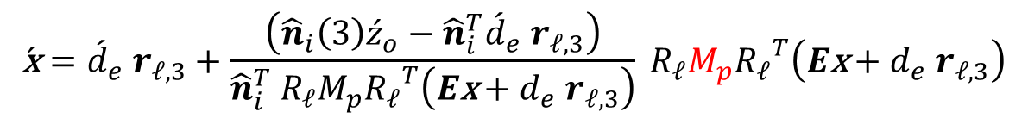
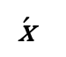
THE MATH
Chief ray
$${\hat{n}}_{i}$$
Pivots
IMAGE PLANE
$${\hat{n}}_{o}$$
OBJECT PLANE
Meridional Plane
$$\text{x}(x, y, z)$$
$${\hat{c}}_{y}$$
$$l$$
$$\acute{E}$$
$${\hat{i}}_{y}$$
$${\hat{i}}_{z}$$
$$\left\{O\right\}$$
$$\acute{ω}$$
$$\left\{I\right\}$$
$$α_{L}$$
$$ω$$
$$E$$
$$\left\{C\right\}$$
$${\hat{c}}_{z}$$
$$\left\{P\right\}$$
$$\acute{l}$$
OPTICAL AXIS (OA)
$$\acute{\text{x}}(\acute{x}, \acute{y},\acute{z})$$
y
x
$$d_{e}$$
$${\acute{d}}_{e}^{ }$$
y
x
SAGITTAL Plane
z
$$z$$
$$\acute{z}$$
z
$$z_{o}$$
$${\acute{z}}_{o}^{ }$$
Relation between object point and corresponding image point :
$$\text{x}$$
$$\acute{\text{x}}$$
$$\begin{aligned}\acute{\text{x}}=&{\acute{d}}_{e} r_{𝓁,3}&+\frac{\left({\hat{n}}_{i}\left(3\right){\acute{z}}_{o}−{\hat{n}}_{i}^{T}{\acute{d}}_{e} r_{𝓁,3}\right)}{{\hat{n}}_{i}^{T}{}_{ }^{ }{R_{𝓁}}M_{p}{R_{𝓁}}^{T}\left(E\text{x}+d_{e} r_{𝓁,3}\right)}{}_{ }^{ }{R_{𝓁}}M_{p}{R_{𝓁}}^{T}\left(E\text{x}+d_{e} r_{𝓁,3}\right) \\ \end{aligned}$$
Update to the Gaussian Lens Formula:
$$M_{p}=\left[\begin{matrix}1 & 0 & 0 \\ 0 & 1 & 0 \\ 0 & 0 & m_{p}\end{matrix}\right]$$
$$−\frac{{\tilde{\hat{n}}}_{o}}{m_{p}\left[z_{o}+d_{e}\left({\tilde{\hat{n}}}_{o}^{T}r_{𝓁,3}\right)\right]}+\frac{{}_{ }^{ }{R_{𝓁}}M_{p}{R_{𝓁}}^{T}{\tilde{\hat{n}}}_{i}}{\left[{\acute{z}}_{o}−{\acute{d}}_{e}\left({\tilde{\hat{n}}}_{i}^{T}r_{𝓁,3}\right)\right]}=\frac{r_{𝓁,3} }{f}$$

Slide 11
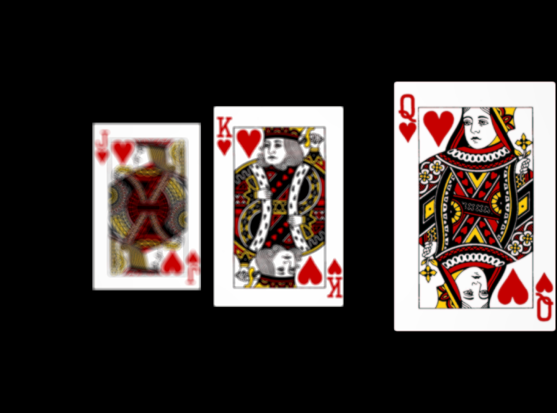
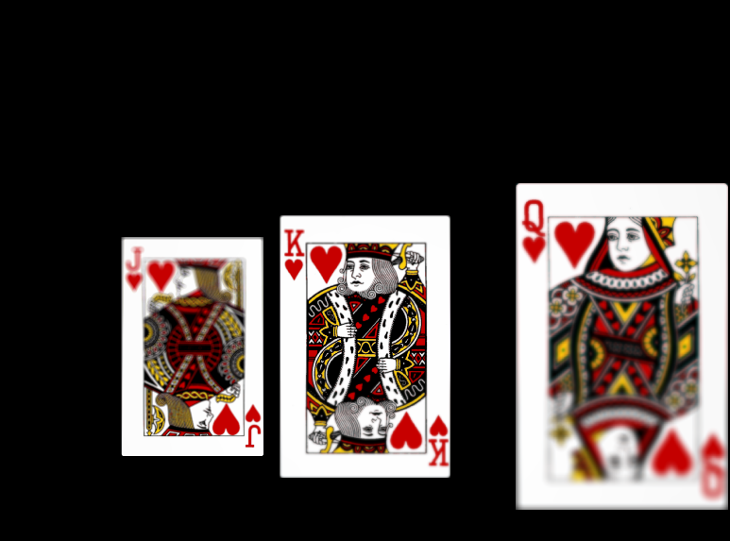
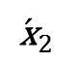
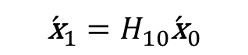
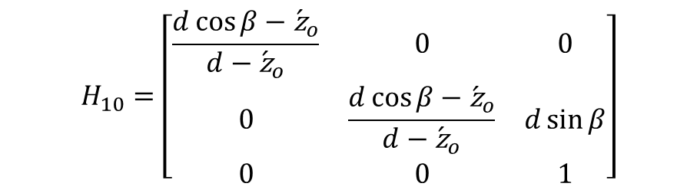
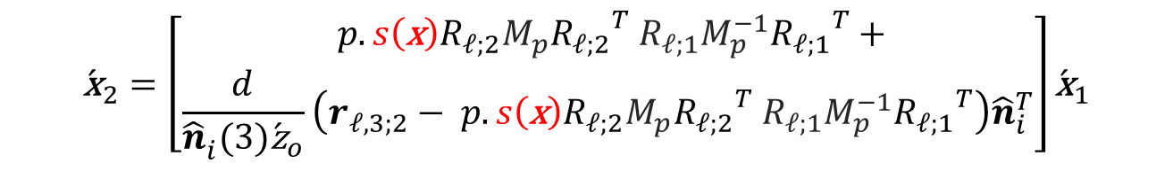


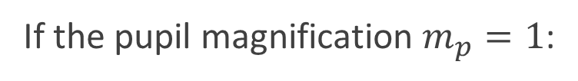
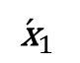
THE MATH
Relation between image point and corresponding image point
for two observations (tilts of the lens):
$${\acute{\text{x}}}_{2}$$
$${\acute{\text{x}}}_{1}$$
$$\begin{aligned}{\acute{\text{x}}}_{2}=&\left[\begin{aligned}{}_{ }^{ }{p.s\left(\text{x}\right)R_{𝓁;2}}M_{p}{R_{𝓁;2}}^{T}{}_{ }^{ }{R_{𝓁;1}}M_{p}^{−1}{R_{𝓁;1}}^{T}+ \\ \frac{d}{{\hat{n}}_{i}^{ }(3){\acute{\text{z}}}_{o}}\left(r_{𝓁,3;2}−{}_{ }^{ }{p.s\left(\text{x}\right)R_{𝓁;2}}M_{p}{R_{𝓁;2}}^{T}{}_{ }^{ }{R_{𝓁;1}}M_{p}^{−1}{R_{𝓁;1}}^{T}\right){\hat{n}}_{i}^{T}\end{aligned}\right]{\acute{\text{x}}}_{1} \\ \end{aligned}$$
If the pupil magnification $m_{p}=1$:
$$H_{10}=\left[\begin{matrix}\frac{d\cos{β}−{\acute{\text{z}}}_{o}}{d−{\acute{\text{z}}}_{o}} & 0 & 0 \\ 0 & \frac{d\cos{β}−{\acute{\text{z}}}_{o}}{d−{\acute{\text{z}}}_{o}} & d\sin{β} \\ 0 & 0 & 1\end{matrix}\right]$$
$${\acute{\text{x}}}_{1}=H_{10}{\acute{\text{x}}}_{0}$$
$${\acute{\text{x}}}_{0}$$
$${\acute{\text{x}}}_{1}$$

Slide 12
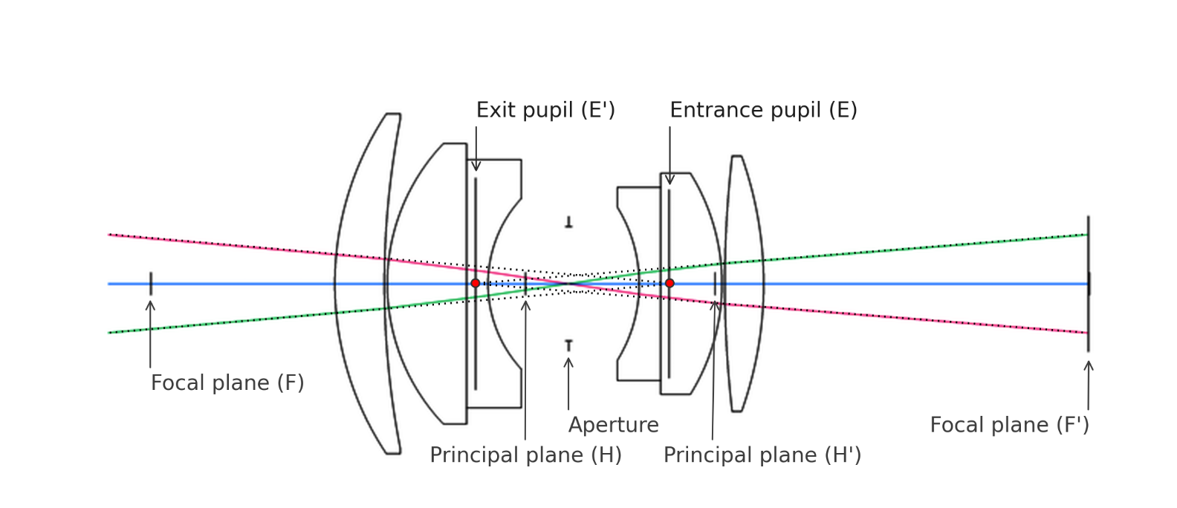
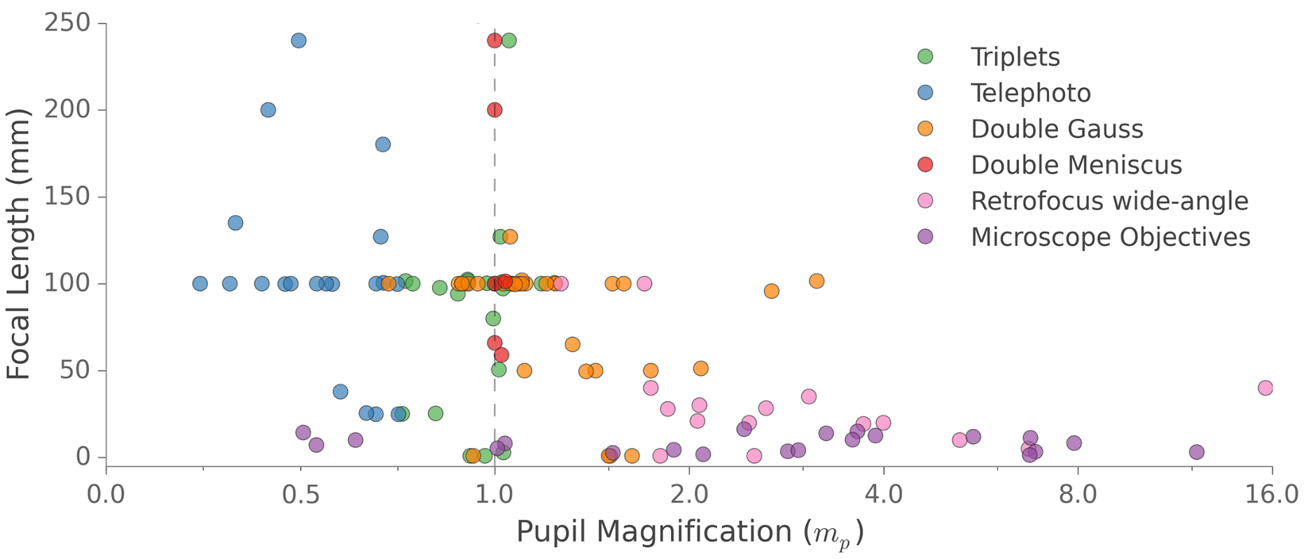
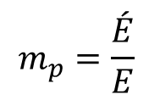
PUPIL MAGNIFICATION
$$m_{p}=\frac{\acute{E}}{E}$$
Survey of pupil magnification

Slide 13
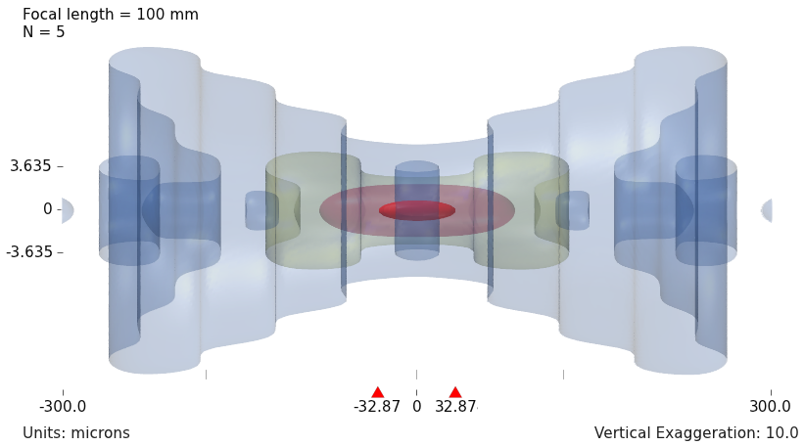
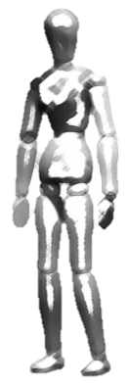
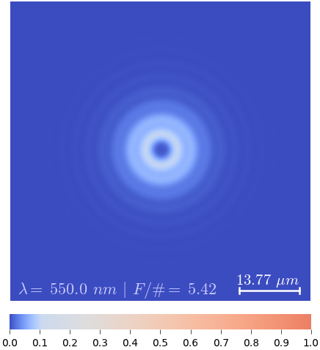
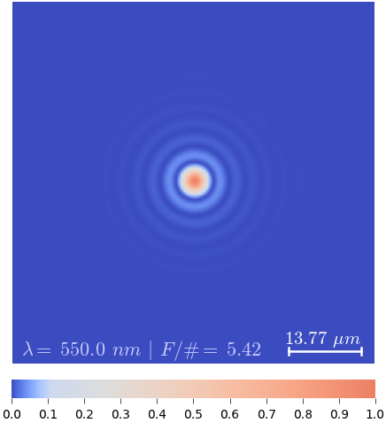
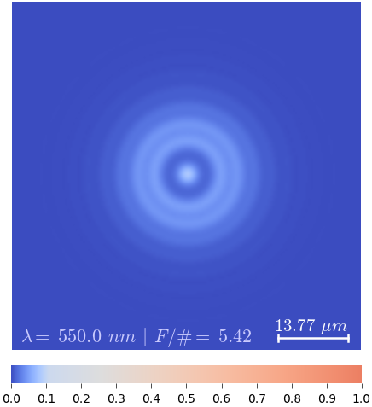
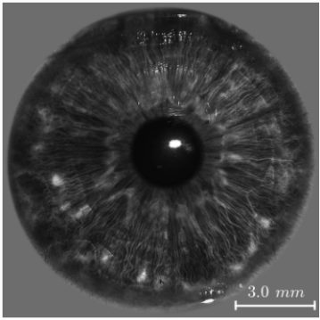
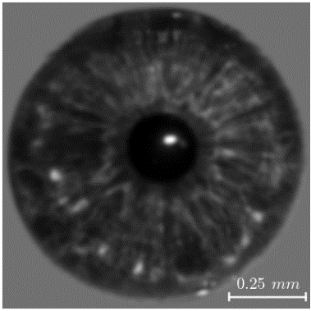

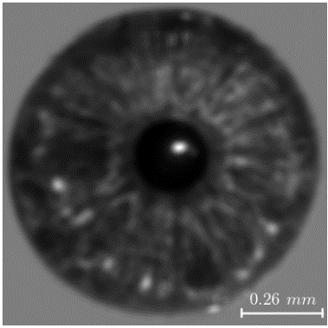
MY THESIS PROBLEM
Image capture for Iris recognition with a large volume
1300 mm
108.33 mm
5%
1%
18 mm
25 mm
80%
20%
B
A
C
100 mm, f/5
▴ Imaging system
C’
A’
B’
▴ 3D Incoherent PSF
DOF
B’
A’
C’
▴ Object space
▾ Iris in object space
B/A/C
B’
A’
C’

Slide 14
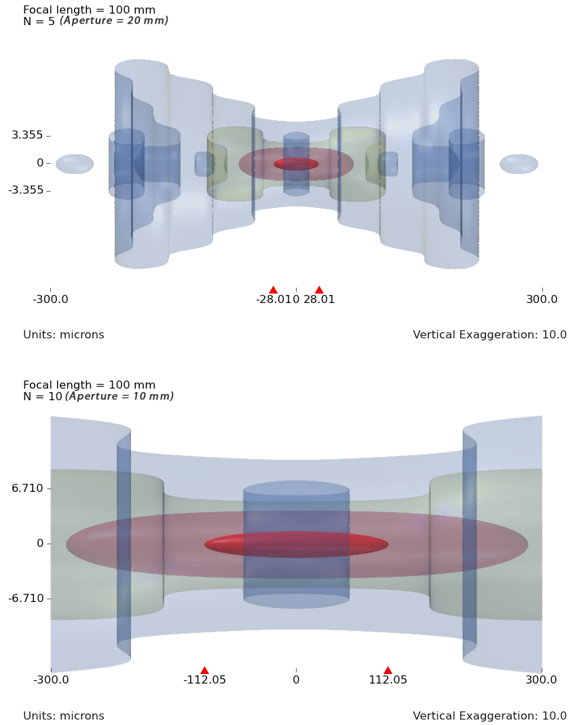
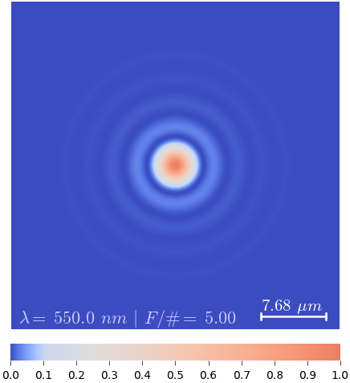
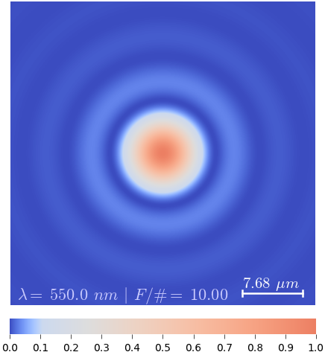
MY THESIS PROBLEM
Controlling DOF by decreasing aperture size
18 mm
25 mm
B
A
C
Focal length = 100 mm
F/# = 5 (aperture = 20 mm)
5%
1%
80%
20%
▴▾ Object space ▴▾ Aperture ▴▾ 3D Incoherent PSF ▴▾ 2D PSF at focus
(DOF indicated by hor. bar)
Focal length = 100 mm
F/# = 10 (aperture = 10 mm)
5%
1%
80%
20%

